Slide 1
Efficient Data Import in R
Michael Otterstatter
BCCDC Biostats Session
Feb 15, 2019

Slide 2
Outline
Data import tools in tidyverse
Reading csv files
Formatting columns
Dealing with missing values
Dealing with dates
Reading other file types

Slide 3
Importing data
Regardless of the analytic task, we almost always begin by taking data from an existing source (file, webpage, database) and importing it into an object in R, SAS, etc. for further manipulation and analysis

Slide 4
Importing data with readr
readr can import from 7 different file formats:
read_csv(): comma separated (csv) files
read_tsv(): tab separated files
read_delim(): general delimited files
read_fwf(): fixed width files
read_table(): tabular files with columns separated by white-space.
read_log(): web log files
All have similar form and syntax, so we will focus on read_csv the most commonly used example

Slide 5
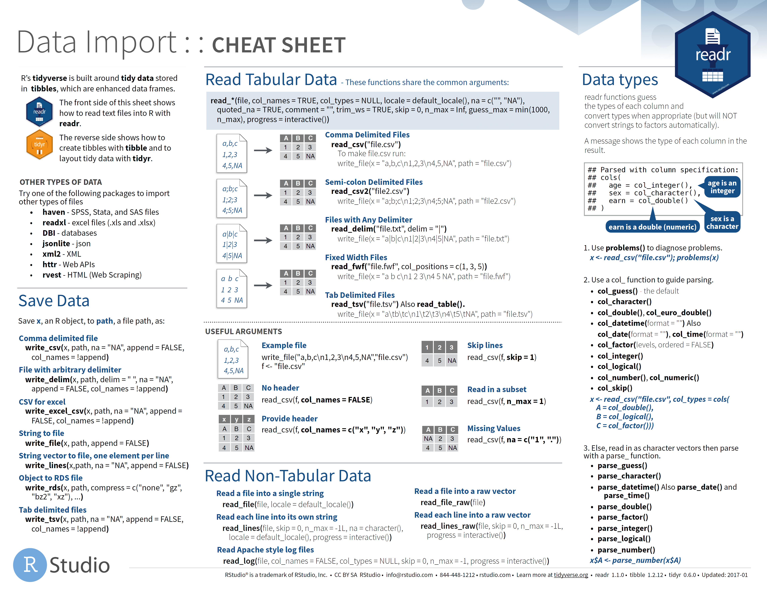
https://www.rstudio.com/resources/cheatsheets/

Slide 6
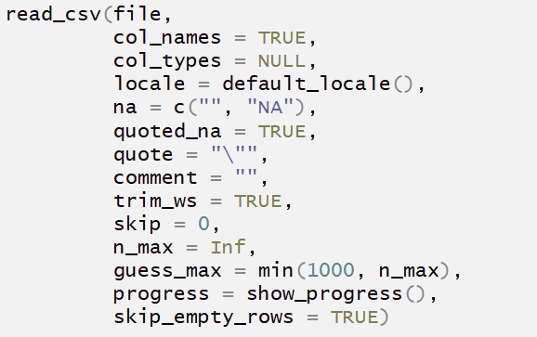
Introducing read_csv
Many options can be specified in read_csv (although usually don’t need to be)

Slide 7
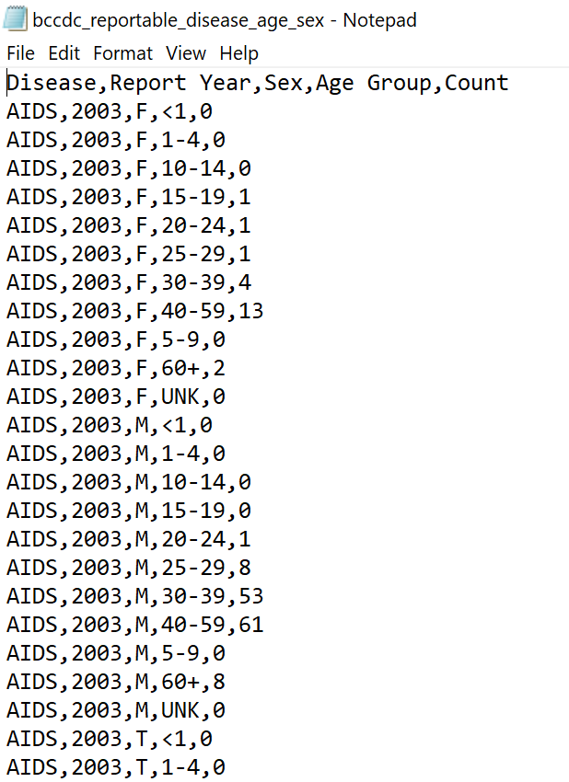
Let’s use the BCCDC reportable disease dashboard data by age and sex as an example
http://www.bccdc.ca//health-professionals/data-reports/reportable-diseases-data-dashboard

Slide 8
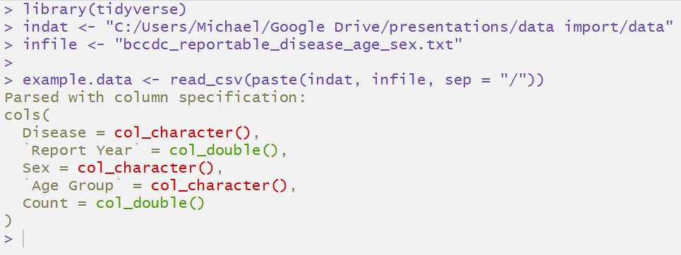
Importing data with read_csv
Most of the time, you only need to specify the file location and read_csv will helpfully do the rest

Slide 9
Importing data with read_csv
Most of the time, you only need to specify the file location and read_csv will helpfully do the rest
Note that readr has guessed the appropriate column formats, but tells you explicitly in case any are incorrect

Slide 10
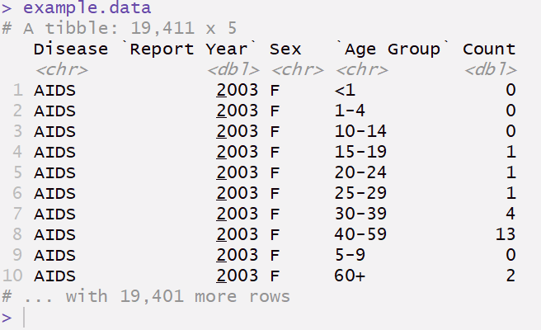
Importing data with read_csv
What did read_csv do?

Slide 11
Importing data with read_csv
Imports data as a ‘tibble’ (user friendly version of a data frame
What did read_csv do?
Preserves column names

Slide 12
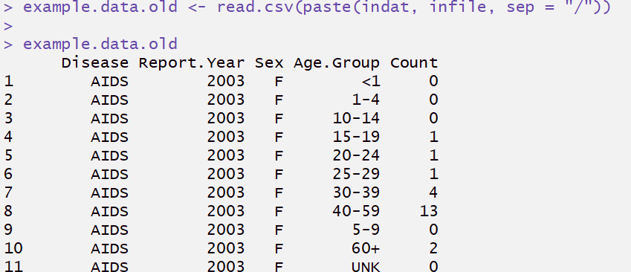
What about read.csv?
Base R uses data import function read.csv

Slide 13
What about read.csv?
What did read.csv do?
Imports data as a ‘data frame’
May change column names
Doesn’t indicate, dataset size or column formats

Slide 14
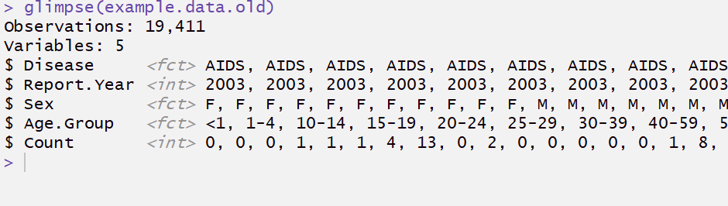
What about read.csv?
What did read.csv do?
Imported character variables as factors (which can cause problems later and should generally be avoided)

Slide 15
What about read.csv?
Compared to the base R function read.csv, read_csv
retains original column names
is much faster (up to 10x)
does not convert character strings to factors by default
automatically parses common date/time formats
has a progress bar if loading is slow

Slide 16
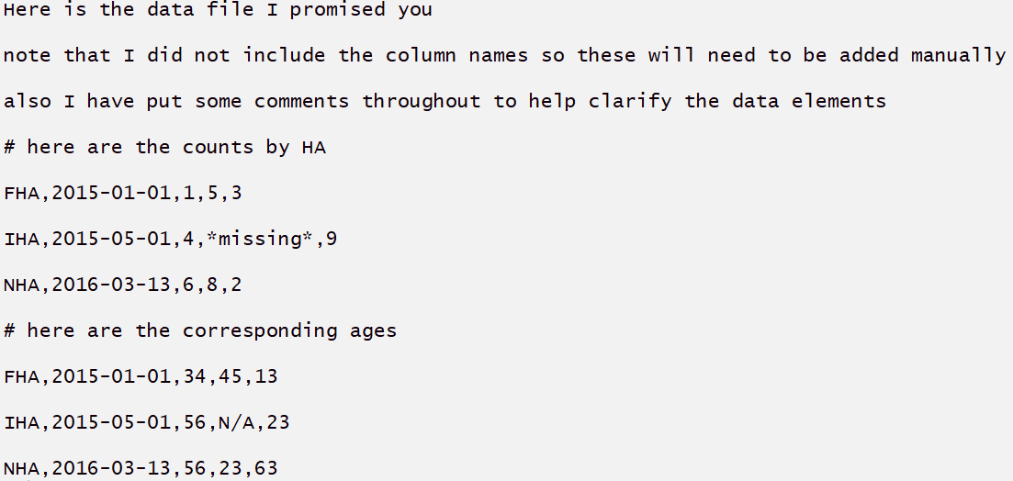
A messier example
What if we receive the data as a text file or spreadsheet with unneeded text and comments interspersed with the data?

Slide 17
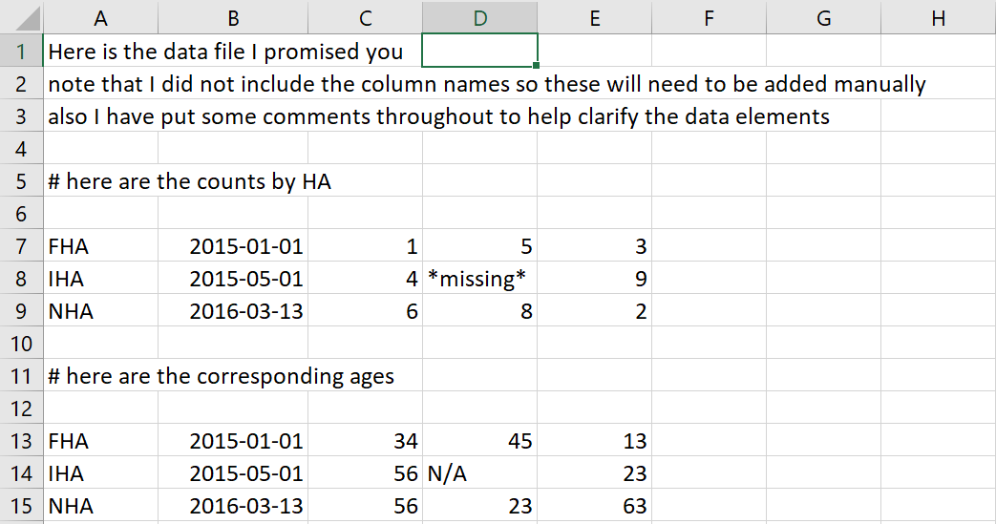
A messier example
What if we receive the data as a text file or spreadsheet with unneeded text and comments interspersed with the data?

Slide 18
A messier example
We can make use of optional settings in read_csv

Slide 19
A messier example
We can make use of optional settings in read_csv
add column names
specify codes indicating missing data
specify codes indicating comments
number of rows to skip at beginning
drop rows with no data

Slide 20
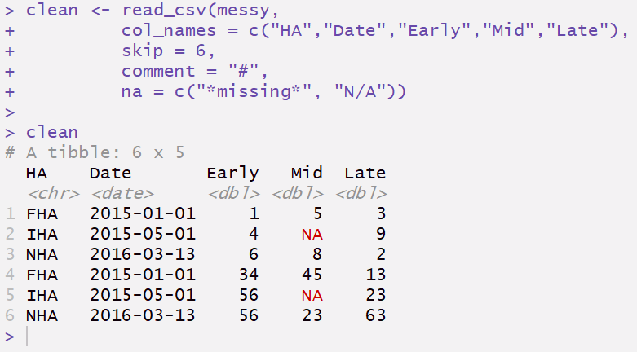
A messier example

Slide 21
A messier example
Specify column names
Skip beginning rows and comments
Specify codes used for missing data
Also, by default read_csv automatically skipped empty rows

Slide 22
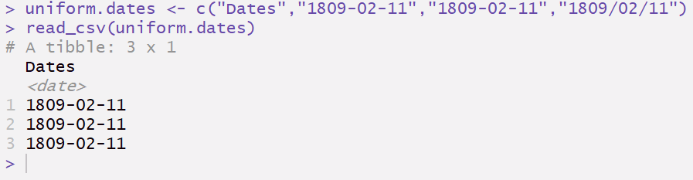
Dealing with dates
read_csv recognizes dates that are uniformly presented (e.g., all in the form year, month, day)

Slide 23
Dealing with dates
read_csv recognizes dates that are uniformly presented (e.g., all in the form year, month, day)
Properly formatted as a date

Slide 24
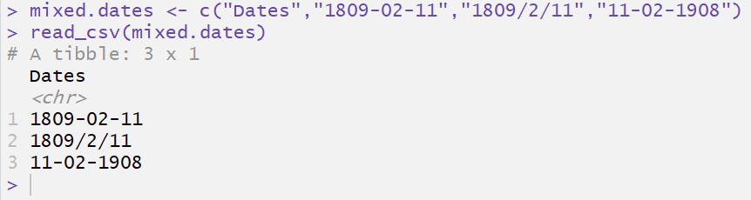
Dealing with dates
When dates are not uniformly presented, read_csv simply formats as character (i.e., preserves the original data) and let’s you do the clean-up
when in doubt, formatted as a character

Slide 25
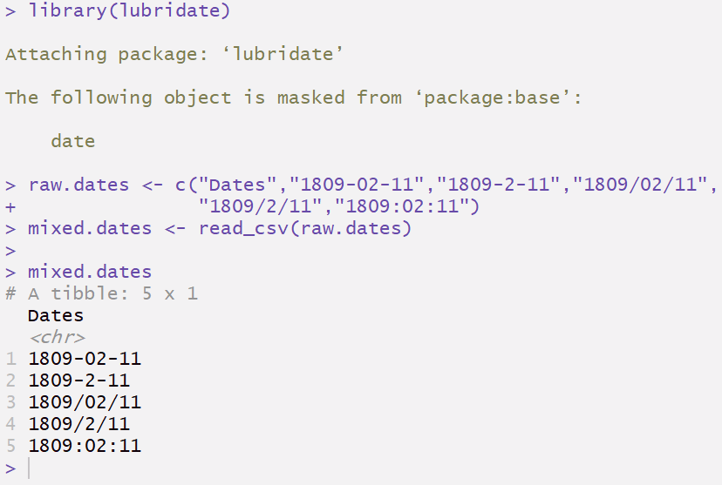
Dealing with dates
Fortunately, with tidy data tools like the lubridate package, working with dates is easy

Slide 26
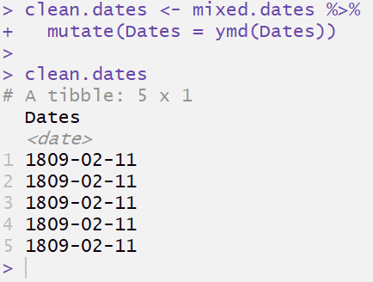
Dealing with dates
We only need specify the ordering of the date components (e.g., ymd indicates year, month, day order), lubridate does the rest
Now properly formatted as a date

